Slide 1

End-to-End Stock Market Trading & Portfolio Performance Analytics Platform
A Data Engineering & Analytics Solution
Presented by: Gayathri Pavushetty

Slide 2
Addressing Critical Business Challenges in Financial Data
Raw Data Fragmentation
Manual Analysis Limitations
Stock market data often exists in separate CSV files, lacking immediate structure and uniform access for comprehensive analysis.
Traditional manual data analysis methods are prone to inconsistencies and cannot scale efficiently with increasing data volumes or complexity.
Lack of Unified View
Inefficient Tracking
Stakeholders lack a consolidated perspective on overall portfolio performance, risk exposure, and granular insights into various financial metrics.
Difficulties in accurately tracking returns, measuring volatility, and assessing sector-specific exposures hinder timely and strategic decision-making.

Slide 3





Comprehensive Solution Overview
Automated Data Ingestion
Streamlined processes for automatic data acquisition and initial validation from diverse sources.
Structured ETL Pipeline
Implementation of a robust Bronze–Silver–Gold architecture for efficient data transformation and enrichment.
Advanced Financial Analytics
Sophisticated algorithms to compute key financial metrics including returns, volatility, and deep portfolio insights.
Interactive Dashboards
Intuitive visualization tools providing actionable insights for informed and agile investment decision-making.

Slide 4






Robust Technology Stack for Scalable Analytics
Python
Pandas & NumPy
Core language for data ingestion, complex analytics, and custom script development.
Essential libraries for efficient time-series analysis and numerical operations on financial data.
Databricks & PySpark
Delta Lake
Enabling scalable data processing and analysis across large datasets with distributed computing.
Providing reliable, ACID-compliant storage for structured and semi-structured data with schema enforcement.
Apache Airflow
Power BI
Orchestrating complex data pipelines and workflows for automated, scheduled operations.
Developing interactive and dynamic dashboards for comprehensive visualization and reporting.

Slide 5
End-to-End Data Pipeline Architecture
1
Raw CSV Stock Data
2
Python Ingestion & Validation (Pandas)
3
Bronze Layer – Delta Tables (Databricks)
4
Silver Layer – Cleaned & Enriched Data
5
Gold Layer – Aggregated Business Metrics
6
Apache Airflow Orchestration
7
Power BI Dashboards

Slide 6
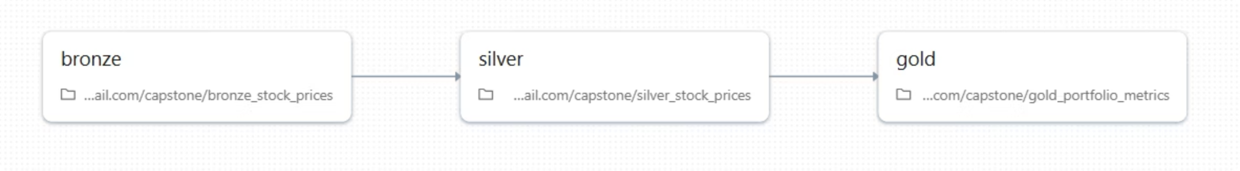
Data Architecture: Bronze, Silver, Gold
Raw Ingested Data
1
Unmodified raw data loaded directly from source systems, preserving original format and integrity for auditing and lineage.
Cleaned & Validated Data
2
Curated and enriched datasets, normalized for consistency, and ready for advanced analytics. Includes features engineering and data quality checks.
Business-Level Metrics
3
Highly aggregated, optimized datasets for direct consumption by business intelligence tools and final reporting. Focus on KPIs and strategic insights.

Slide 7
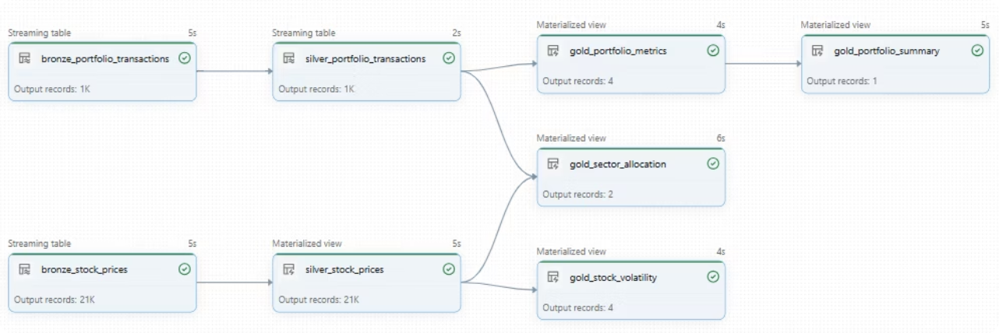
ETL & Data Processing Flow
Our robust ETL process ensures data integrity and prepares financial information for advanced analysis.
1
2
Extract Data
Transform with PySpark & Pandas
Historical stock prices and portfolio transaction records are extracted directly from designated CSV files.
Data undergoes cleaning, aggregation, and feature engineering using the powerful capabilities of Pandas and PySpark for efficient processing.
3
4
Load to Delta Tables
Maintain Data Quality
Curated and transformed datasets are loaded into Delta Lake tables, ensuring data reliability and versioning.
Continuous monitoring and validation enforce strict data quality standards and schema consistency across all layers.

Slide 8
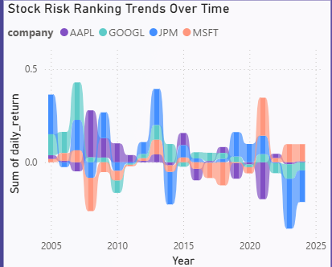
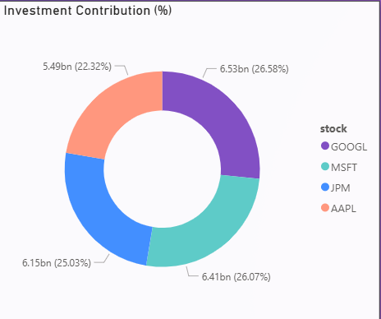
Key Financial Analytics Implemented
Unlock deeper insights into market movements and portfolio health through a suite of critical financial metrics.
1
Daily Return Calculation
Automated computation of daily percentage changes in stock prices to evaluate short-term performance.
2
Moving Averages
Application of various moving average models (e.g., SMA, EMA) for robust trend identification and smoothing price fluctuations.
3
Volatility Measurement
Quantification of asset price fluctuations to assess market risk and inform risk management strategies.
4
Portfolio Investment Metrics
Comprehensive metrics including weighted returns, Sharpe ratio, and alpha/beta analysis for holistic portfolio performance evaluation.

Slide 9
Workflow Automation with Apache Airflow
1
2
3
Apache Airflow serves as the central orchestrator for our entire data engineering pipeline, ensuring seamless, reliable, and automated execution of all tasks.
End-to-End Pipeline Orchestration:
Correct Execution Order:
Guarantees that each step in the pipeline runs only after its prerequisites are met, preventing data inconsistencies.
Airflow manages the complete workflow, from data ingestion to analytics processing and reporting, maintaining logical dependencies.
4
5
Scheduling and Monitoring:
Resilience and Retries:
Enables scheduled execution of daily, weekly, or monthly jobs, complemented by robust monitoring features to track progress and identify issues.
Configurable retry mechanisms and error handling enhance pipeline resilience, minimizing manual intervention.

Slide 10
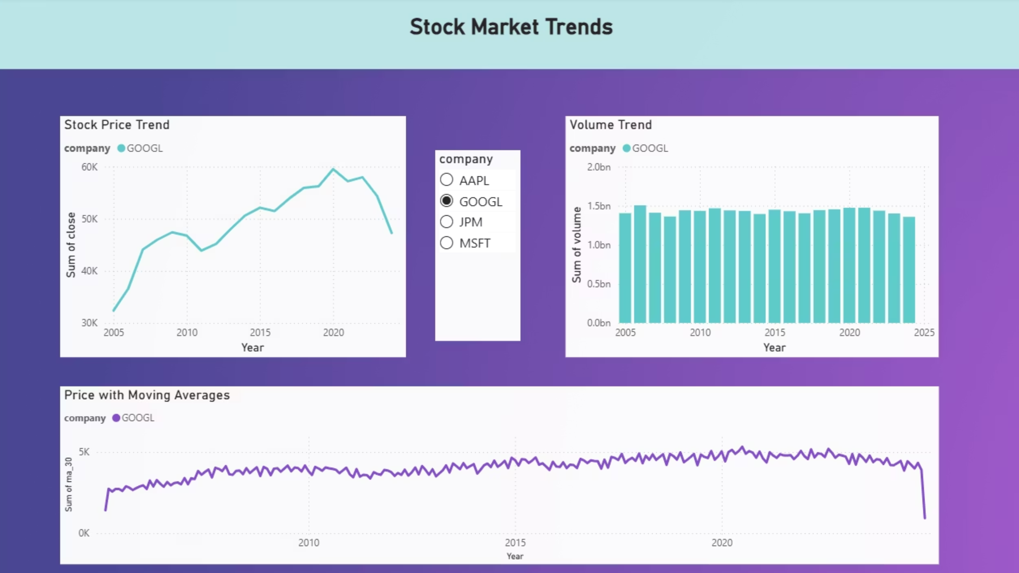
Analysis & Insights: Stock Market Trends Dashboard
Our interactive dashboard reveals critical patterns in market data, empowering data-driven investment decisions with clarity and precision.
Stock Price Trends
Volume Dynamics
Observe the consistent upward trajectory across major tech stocks (AAPL, MSFT, GOOGL), reflecting strong investor confidence and sustained growth.
Healthy trading volumes accompanying price movements indicate robust market liquidity and broad participation, validating market sentiment.
Moving Averages for Analysis
Steady Growth in Tech
Moving Averages clearly delineate uptrends and pinpoint key support/resistance levels, offering crucial signals for strategic entry and exit points.
The convergence of consistent price appreciation, significant trading volume, and clear moving average signals underscores the sustained growth observed within the technology sector.

Slide 11
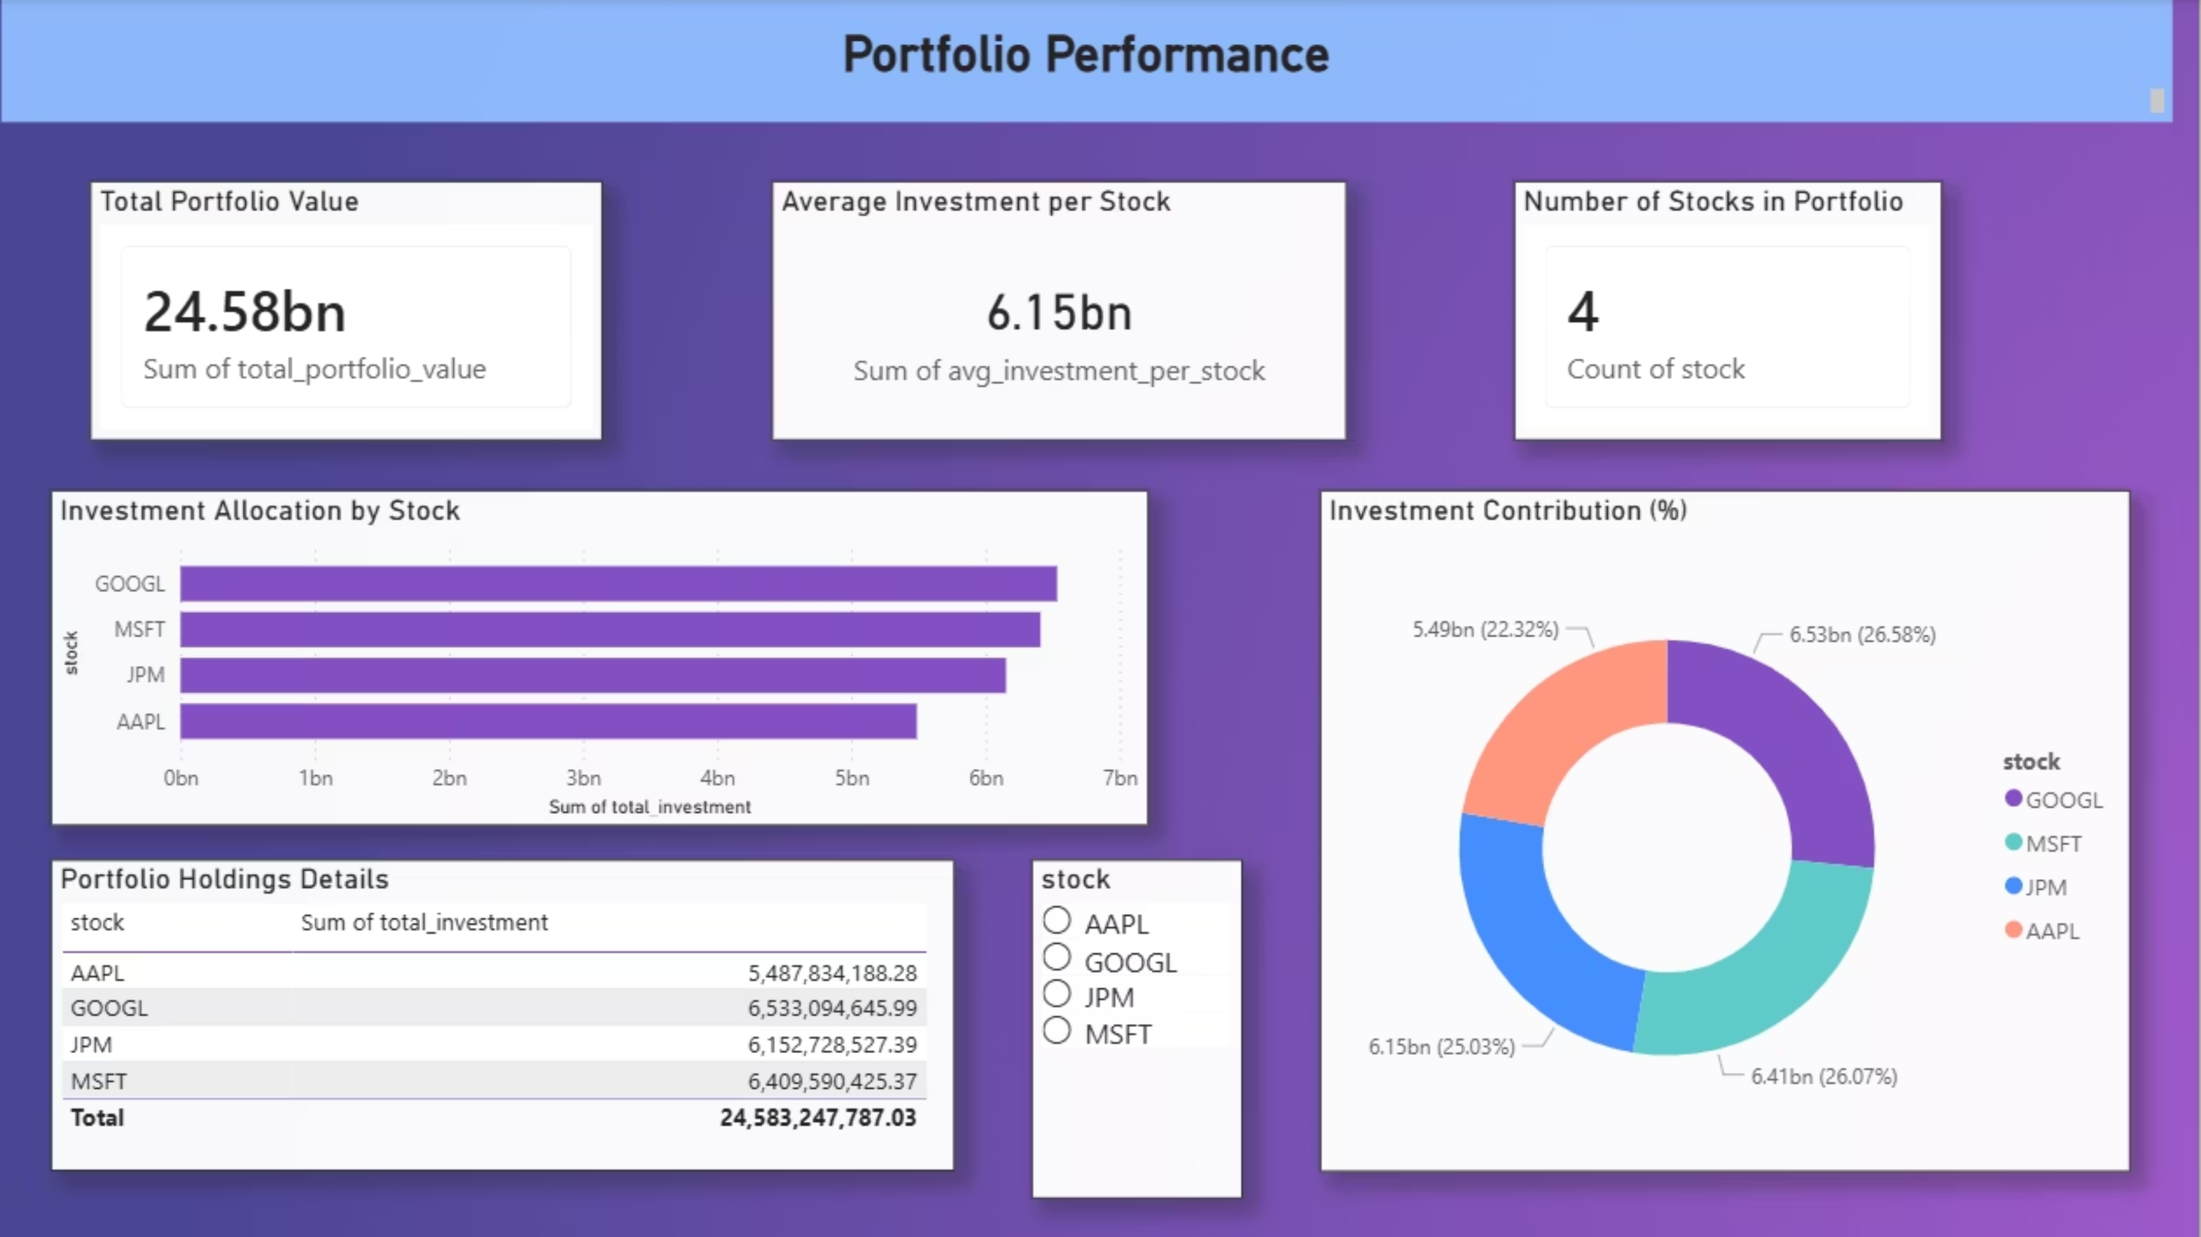
Analysis & Insights: Portfolio Performance Dashboard
Portfolio Performance
Total Portfolio Value: $24.58bn
Average Investment per Stock: $6.15bn
Portfolio composition: 4 major tech stocks (AAPL, MSFT, GOOGL, AMZN)
Key insight: Balanced allocation across tech leaders with AAPL as largest position

Slide 12
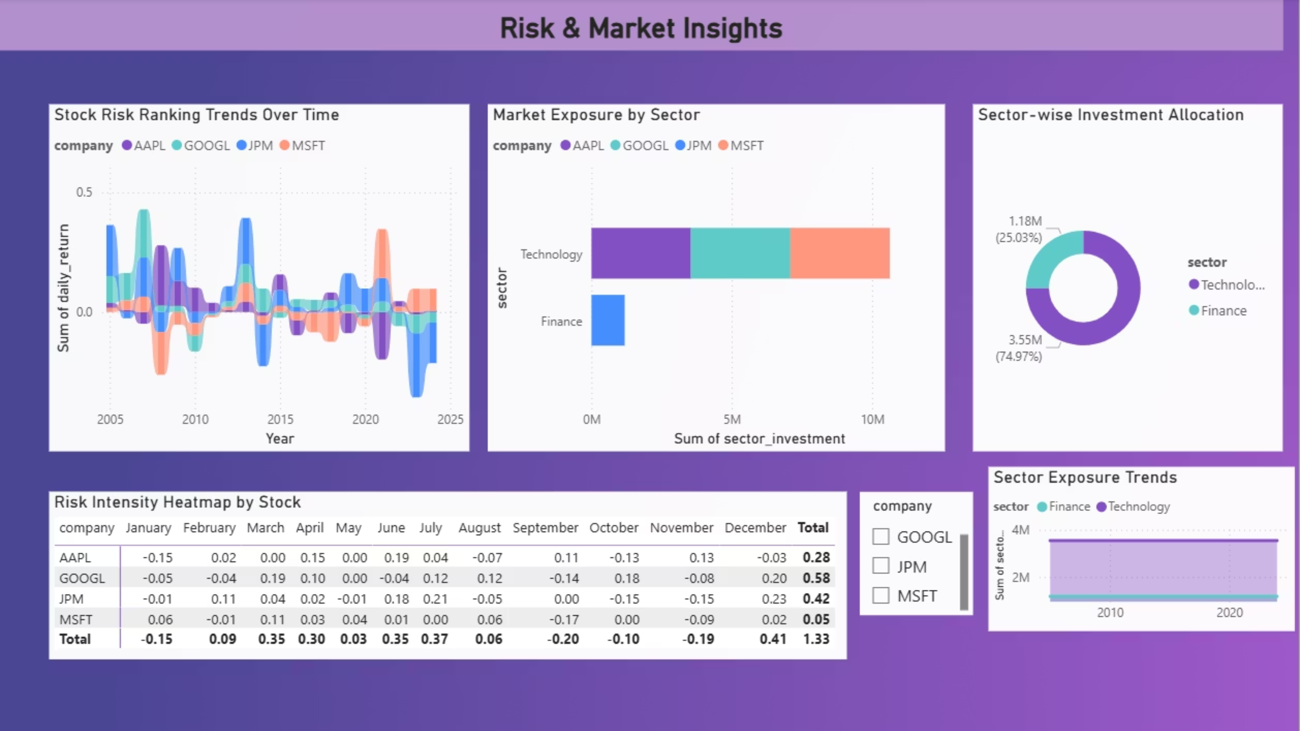
Analysis & Insights: Risk & Market Insights Dashboard
Risk & Market Insights
Stock Risk Ranking Trends
Market Exposure by Sector
Sector Investment Allocation
Monitor evolving volatility and individual stock risk assessments, identifying shifts in market perception over time.
Clear capital distribution across sectors, highlighting diversification and potential concentration risks.
View allocated capital per sector, supporting strategic asset rebalancing and targeted investment.
Risk Intensity Heatmap
Sector Exposure Trends
Visualizes monthly risk metrics and volatility trends for quick identification of high-risk periods or assets.
Track dynamic changes in sector exposure, enabling proactive adjustments to market positioning and risk management.

Slide 13








Dynamic Dashboards & Actionable Insights (Power BI)
Interactive Power BI dashboards provide stakeholders with clear, concise, and customizable views of critical financial data, enabling rapid decision-making.
Stock Price Trends
Portfolio Performance
Visualize historical price movements, identify patterns, and analyze moving averages for strategic entry/exit points.
Track overall portfolio gains/losses, assess asset allocation, and benchmark against market indices.
Sector Exposure
Risk & Volatility
Gain insights into sector-wise market exposure, diversification levels, and identify potential concentration risks.
Monitor portfolio volatility, understand risk contributions from individual assets, and manage exposure effectively.

Slide 14




Conclusion: Empowering Data-Driven Finance
Our end-to-end financial analytics solution is designed to transform complex data into clear, actionable intelligence, driving smarter investment decisions and robust portfolio management.
Integrated Platform
Accelerated Insights
A unified pipeline from data ingestion to dynamic dashboards, built for reliability and efficiency.
Enable quicker, more informed investment choices with real-time access to critical financial metrics.
Strategic Advantage
Future-Proof Foundation
Optimize investment strategies, manage risk proactively, and unlock new avenues for portfolio growth.
A scalable and adaptable architecture ready to meet evolving market demands and analytical needs.

